Slide 1
LENDING CLUB ASSIGNMENT
SUBMISSION
Group Facilitator: Reshma Ranjitkumar Shenoy
Team Member : Mayank Shekhar

Slide 2
ABSTRACT
Problem statement :
Find the driving factors behind loan defaulters which in return will decrease the credit loss.
Constraints :
No Business Constraints
Dataset description :
Loan.csv : It contains the complete loan data for all loans issued through the time period 2007 to 2011.
Data_Dict.xlsx : It contains meta data of each columns.

Slide 3
Methodology
Approach Taken
Considering each column and deciding which is useful metric
Data | Statistics
Total no of columns | 111
Total no of columns considered | 16
Considered columns | Grade, term,, 'member_id', 'loan_amnt', 'term', 'int_rate','grade', 'emp_length', 'home_ownership', 'annual_inc', 'verification_status', 'loan_status', 'desc', 'purpose', 'dti', 'delinq_2yrs', 'pub_rec', 'revol_bal', 'revol_util',, 'pub_rec_bankruptcies'
Derived columns | int_rate_level, loan_amnt_level, annual_inc_level, has_desc, dti_level, loan_income_ratio, loan_income_ratio_level, revol_util_level
Data cleaning with imputations/removal/data_types etc
Univariate Analysis: Each finalized columns are tested, plotted and analyzed.
Bivariate Analysis: Pairs of columns are tested,plotted and analyzed
10 most important metric concluded

Slide 4
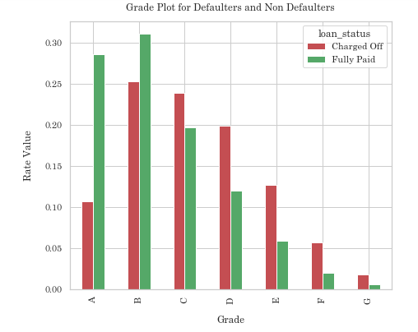
Grade vs Rate of borrowers
Insights :
Grade A, B have more fully paid borrowers as compared to defaulters.
Though there is small difference between fully paid and defaulting, no of defaulters starts to increase from Grade C.
So, we can claim that if the borrower has grade above “C”, he/she is more likely to default.

Slide 5
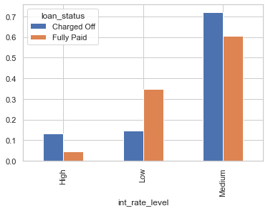
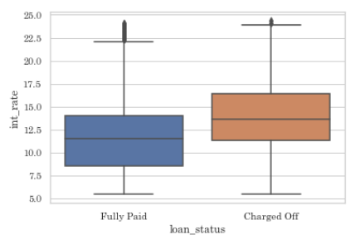
Interest Rate vs Loan Status
Note :
Low : Interest Rate <=10%
Medium : Interest Rate between the range{10,18}
High : Interest Rate >18
Insights :
More no of defaulters lie for the interest rate “medium” and “high”
On an average, most borrowers default if interest rate is above 13%.
So, we can claim that if the interest rate is above 13% then the borrower is more likely to default

Slide 6
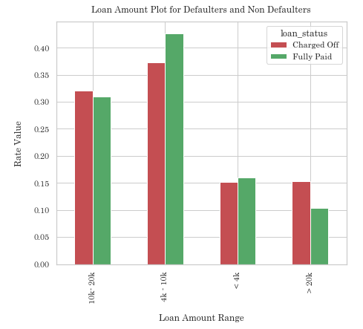
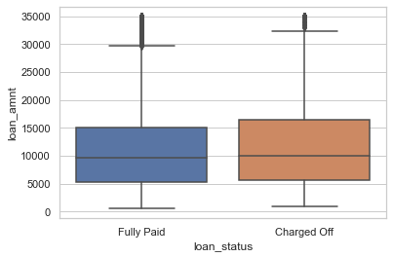
Loan Amount Vs Loan Status
Insights :
If the loan amount is greater than 10K, no of defaulters are more than fully paid.
So, we can claim that if a borrower ask for loan amount greater than 10K, then he/she could probably default hence necessary actions needs to be taken.

Slide 7
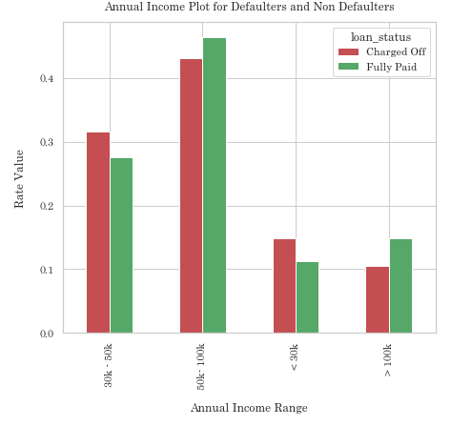
Annual Income Vs Loan Status
Insight:
Borrower having annual income less that 50k are likely to default.
Hence necessary actions wrt interest rates or granted loan amount should be considered.

Slide 8
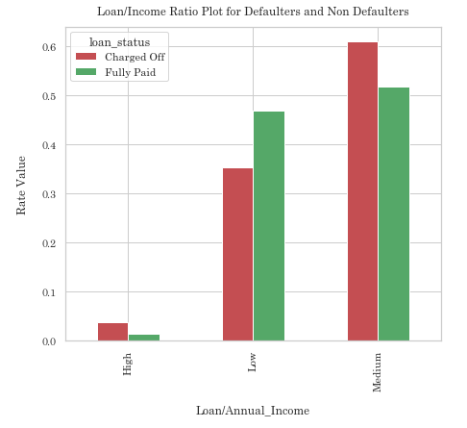
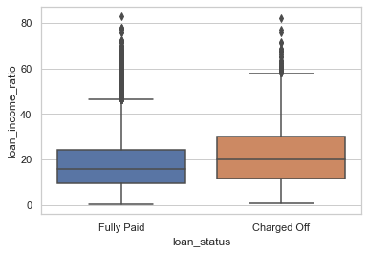
Loan/Annual Income vs Loan Status
Note :
Loan/Annual Income : (Loan amount/Annual Income)*100
Low : Interest Rate <15%
Medium : Interest Rate Between (15,50)
High : Interest Rate>=50
Insights:
Higher the loan/income ratio, more are the defaulters.
On an average, borrowers having loan/annual_income greater than 20% are defaulters.
So, we can claim that if a borrower having a loan/ annual income ratio greater than 20% , is likely to default.

Slide 9
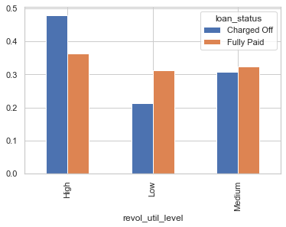
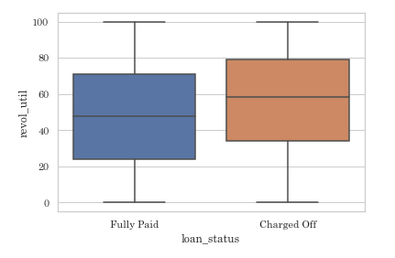
Revolving Utilization Rate vs Loan Status
Note :
Low : Interest Rate <30%
Medium : Interest Rate Between (30,60)
High : Interest Rate>=60%
Insights:
Defaulters generally have high revolving utilization rate.
On an average, borrowers having revolving utilization rate greater than 60% , default.
So, we can claim that if a borrower having a revolving utilization Rate greater than 60% is more likely to default.

Slide 10
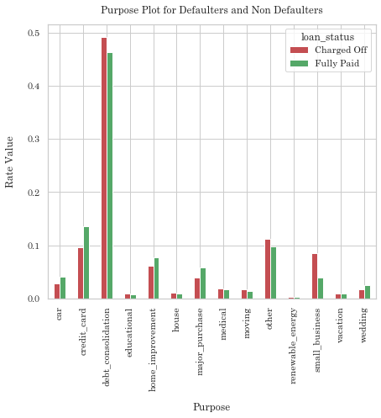
Purpose vs Rate of borrowers
Insights:
There are many borrowers with purpose as debt_consolidation.
But the difference in defaulters and non-defaulters are highest in small_business.
So, we can claim that if a borrower asks loan for small business, there is a high probability of him/her defaulting.

Slide 11
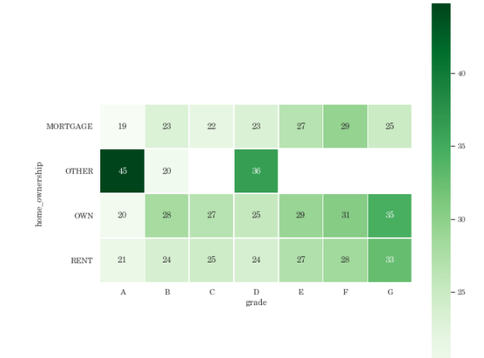
Mean of Loan/Income ratio across Grade and Home_ownership
Note :
Purpose : Debt_consolidation
For defaulters only
Insights:
If a borrower doesn't mention his/her home ownership(i.e. other or None) and lies in grade A with purpose of debt_consolidation, loan to income ratio is observed to be very high.
So, we can claim that if a borrower satisfies above conditions, there are a high chances of defaulting.

Slide 12
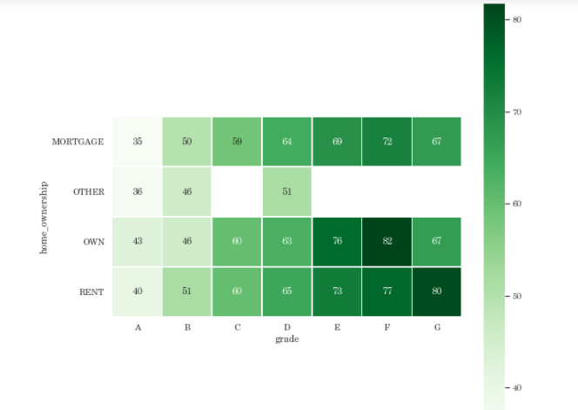
Mean of Revol_util across Grade and Home_ownership
Note :
Purpose : Debt_consolidation
For defaulters only
Insights:
If a borrower with purpose of debt_consolidation, having a revolving utilization rate greater than 70% and staying in owned or rented house, then he/she may have more probability of defaulting..
So, we can claim that if a borrower satisfies above conditions, there are a high chances of defaulting.

Slide 13
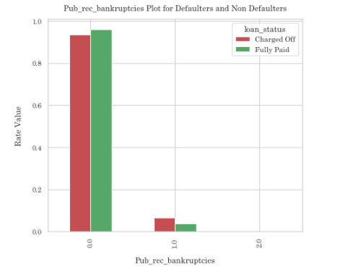
Rate of borrowers vs Public record for bankruptcies
Insights:
Borrower with any public bankruptcy record has a higher chance of defaulting
So, we can claim that if a borrower has a public bankruptcy record, there is a high chance of him/her defaulting.

Slide 14
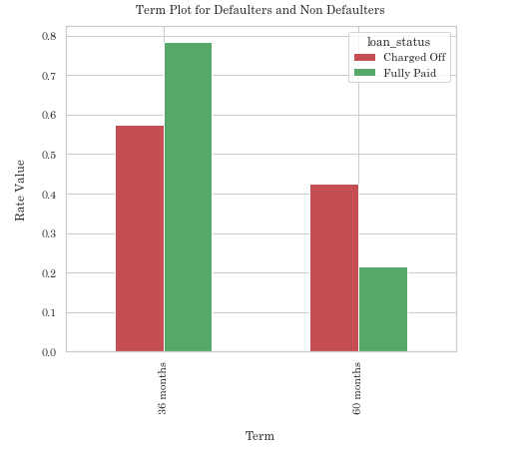
Term vs Rate of borrowers
Insights:
Borrowers with term 60 months have evidently larger number of defaulting.
So, we can claim that higher the term, higher are the chances of defaulting.

Slide 15
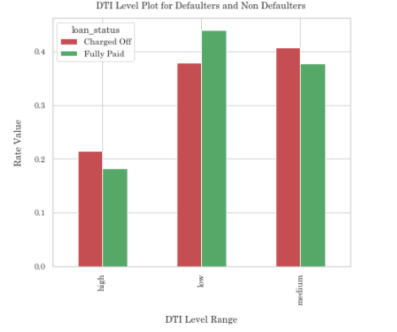
DTI vs Rate of borrowers
Note :
Low : dti value <12
Medium : dti value is between (12,20)
High : dti value >=20
Insights:
If the DTI is medium or high then chances of the borrower to default is high.
So, we can claim more specifically that borrowers with the dti greater than 12, more likely default.

Slide 16
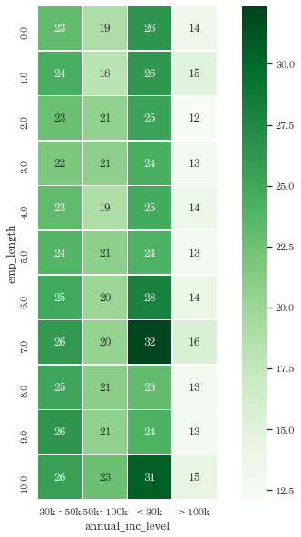
Mean of loan/income for Employment-length and annual_income
Insights:
No of borrowers having high loan to income ratio lies in the income group of less that 30K and with an emp_length of 7 or 10+
So, we can claim that borrowers with satisfying the above conditions, more likely default.

Slide 17
Final Statement
Column | Condition | Chances of defaulting
Grade | >= C | High
Interest Rate | >= 13% | High
Loan Amount | >= 10K | Potentially high
Annual Income | <50K | Potentially high
Loan/Annual Income | >= 20% | High
Revolving Utilization Rate | >= 60% | High
Purpose | Small Business | High
Term | 60 months | High
DTI | > 12% | Potentially high
Conclusion
The table shows top 9 driving factors, strongly indicating chances of defaulting.
Along with these 9 factors, there are several combinations of driving variables, mentioned in the previous slides, which identifies with high loan/income ratio, resulting to a default.

Slide 18
THE END

